Slide 1
Unit 7 : Mobile Application Development - Content Providers

Slide 2
Sharing Data in Android
Content Providers provide an interface for publishing and consuming data, based around a simple URI addressing model using the content: // schema.
They enable you to decouple your application layers from the underlying data layers, making your applications data-source agnostic by abstracting the underlying data source.
Content Providers can be shared between applications, queried for results, have their existing records updated or deleted, and have new records added.
Any application — with the appropriate permissions — can add, remove, or update data from any other application, including the native Android Content Providers.

Slide 3
Sharing Data in Android
Several native Content Providers have been made accessible for access by third-party applications, including the contact manager, media store, and calendar.
By publishing your own Content Providers, you make it possible for you (and other developers) to incorporate and extend your data in new applications.
Unlike a database, a content provider can use different ways to store its data. The data can be stored in a database, in files, or even over a network.

Slide 4
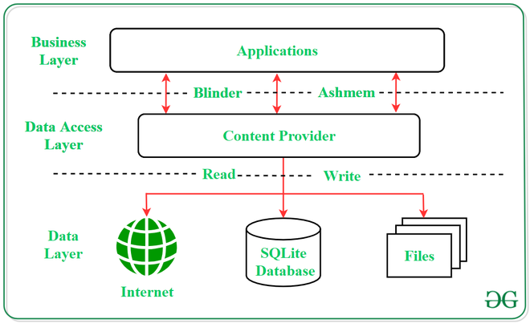
Sharing Data in Android

Slide 5
Content Provider
Android Built-in content providers include the following:
Browser: Stores data such as browser bookmarks, browser history, and so on
CallLog: Stores data such as missed calls, call details, and so on
Contacts: Stores contact details
MediaStore: Stores media files such as audio, video, and images
Settings: Stores the device’s settings and preferences

Slide 6
Content Provider
Besides the many built-in content providers, you can also create your own content providers.
To query a content provider, you specify the query string in the form of a Uniform Resource
Identifier (URI), with an optional specifier for a particular row.
A content provider is implemented as a subclass of ContentProvider class and must implement a standard set of APIs that enable other applications to perform transactions.
public class My Application extends ContentProvider { }

Slide 7
Content Provider
To query a content provider, you specify the query string in the form of a URI which has following format
<standard_prefix>://<authority>/<data_path>/<id>
The various parts of the URI are as follows:
The standard prefix for content providers is always content ://
Mandatory part of the URI as it represents that the given URI is a Content URI.
The authority specifies the name of the content provider.
An example would be contacts for the built-in Contacts content provider. For third-party content providers, this could be the fully qualified name, such as com. wrox.provider or com.marzio.provider.

Slide 8
Content Provider
The data path specifies the kind of data requested.
For example, if you are getting all the contacts from the Contacts content provider then the data path would be people, and the URI would look like this: content ://contacts/people.
The id specifies the specific record requested.
For example, if you are looking for contact number 2 in the Contacts content provider, the URI would look like this: content: //contacts/people/2

Slide 9
Query Strings
QUERY STRING | DESCRIPTION
content ://media/internal/images | Returns a list of the internal images on the device
content ://media/external/images | Returns a list of the images stored on the external storage (for example, SD card) on the device
content ://call_log/calls | Returns a list of calls registered in the Call Log
content ://browser/bookmarks | Returns a list of bookmarks stored in the browser

Slide 10
Predefined Query String Constants
Besides using the query URI, we can use a list of predefined query string constants in Android to specify the URI for the different data types.
For example, besides using the query content :
//contacts/people, you can rewrite this statement:
Uri allContacts = Uri.parse("content://contacts/people");
Using one of the predefined constants in Android, as follows
Uri allContacts = ContactsContract.Contacts.CONTENT_URI;

Slide 11
Projections
The third parameter for the CursorLoader class controls how many columns are returned by the query.
This parameter is known as the projection.
CursorLoader cursorLoader =
new CursorLoader(this, allContacts,PROJECTION,null, null,null);

Slide 12
Projections
You can specify the exact columns to return by creating an array containing the name of the column to return, like this:
String[] projection = new String[]
{
ContactsContract.Contacts._ID,
ContactsContract.Contacts.DISPLAY_NAME,
ContactsContract.Contacts.HAS_PHONE_NUMBER
};
In the preceding example, the _ID, DISPLAY_NAME, and HAS_PHONE_NUMBER fields are retrieved.

Slide 13
Filtering
The fourth and fifth parameters for the CursorLoader class enable you to specify a SQL WHERE clause to filter the result of the query.
For example, the following statement retrieves only the people whose name ends with “Lee”:
CursorLoader cursorLoader = new CursorLoader( this, allContacts,
projection, ContactsContract.Contacts.DISPLAY_NAME + " LIKE '%Lee'", null ,null);

Slide 14
Filtering
Here, the fourth parameter for the CursorLoader constructor contains a SQL statement containing the name to search for (“Lee”). You can also put the search string into the next argument of the method/constructor, like this:
//---Honeycomb and later---
CursorLoader cursorLoader = new CursorLoader(this, allContacts,
projection, ContactsContract.Contacts.DISPLAY_NAME + " LIKE ?", new String[] {"%Lee"}, null);

Slide 15
Sorting
The last parameter of the CursorLoader class enables you to specify a SQL ORDER BY clause to sort the result of the query.
For example, the following statement sorts the contact names in ascending order:
CursorLoader cursorLoader = new CursorLoader(this, allContacts, projection, ContactsContract.Contacts. DISPLAY_NAME + " LIKE ?", new String[] {"%Lee"}, ContactsContract.Contacts.DISPLAY_NAME + " ASC");

Slide 16
Creating Your Own Content Providers
Following are the steps which are essential to follow in order to create a Content Provider:
Create a class in the same directory where the that MainActivity file resides and this class must extend the ContentProvider base class.
To access the content, define a content provider URI address.
Create a database to store the application data.
Implement the six abstract methods of ContentProvider class.
Register the content provider in AndroidManifest.xml file using <provider> tag.

Slide 17
Creating Your Own Content Providers
List of methods which you need to override in Content Provider class to have your Content Provider working
onCreate() This method is called when the provider is started.
query() This method receives a request from a client. The result is returned as a Cursor object.
insert()This method inserts a new record into the content provider.
delete() This method deletes an existing record from the content provider.
update() This method updates an existing record from the content provider.
getType() This method returns the MIME type of the data at the given URI.

Slide 18
THANK YOU

